Slide 1
What standards, relevant to me, are there?
Barbara Reed
Chair, Standards Australia IT 21
Committee on Records and
Document Management Systems

Slide 2
Quick overview – national and international
We have a local committee (IT21) and a set of international committees (ISO TC46,SC11 – Records Management and ISO TC171 – Document and Image Management)
We write local standards for our Australasian community (standards with AS/NZ prefix)
We participate in work for international committees and then choose whether or not to adopt these into the Australasian environment (standards with ISO/AS/NZ prefix)

Slide 3
What standards are there?
Lots!
Covering:
The core (ISO 15489)
Management Systems for Records (ISO 30300 series)
Metadata for records (ISO 23081 series)
Functional requirements (ISO 16175 series)
Work process analysis
Records classification
Risk assessment
Compliance
Migration/conversion
Digitisation
Physical storage
Specific formats – eg micrographic standards
PDF formats (ISO 19005 series)

Slide 4
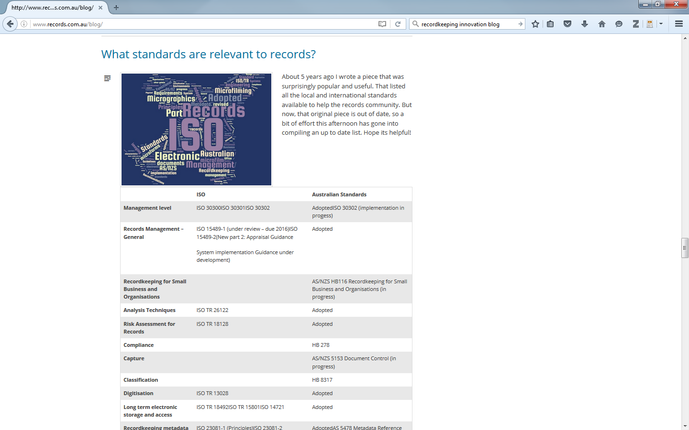
List of standards
Find a list on http://www.records.com.au/blog

Slide 5
How do these standards fit with NSW?
Standards as a pyramid
Jurisdictional
(NSW) Standards
Australasian Standards
ISO Standards

Slide 6
Processes of standardisation
Negotiation
Different cultures, requirements, timing
Reflect current practice or aspire to better practice?
People come in and out
Getting consensus is difficult
Can take years!

Slide 7
ISO 15489 - 2016
Foundation standard for use by records management practitioners
Statement of principles and operational controls and processes

Slide 8
ISO 15489 - Abstract
ISO 15489-1:2016 defines the concepts and principles from which approaches to the creation, capture and management of records are developed. This part of ISO 15489 describes concepts and principles relating to the following:
records, metadata for records and records systems;
policies, assigned responsibilities, monitoring and training supporting the effective management of records;
recurrent analysis of business context and the identification of records requirements;
records controls;
processes for creating, capturing and managing records.
ISO 15489-1:2016 applies to the creation, capture and management of records regardless of structure or form, in all types of business and technological environments, over time.

Slide 9
ISO 15489, 2016 - What’s changed?
Definition of record:
Information created, received and maintained as evidence and as an asset by an organisation or person, in pursuit of legal obligations or in the transaction of business
A greater emphasis on the digital environment (without being media specific)
A greater emphasis on records control tools – metadata, classification, access and security and disposal
A recasting of the analytic approach as appraisal leading to determinations of what records should be captured as well as the more traditional how long should records be kept. Appraisal has become the analytic framework, from which multiple outcomes can be determined.

Slide 10
ISO 30300 – Management Systems series
Not written for records managers, but for management levels – high level, strategic framework for RM – policy, leadership, planning, monitoring
Management system is ‘a framework of policies, procedures, guidelines and associated resources to achieve objectives of organisation’
Management system for records is ‘management system to direct and control an organisation with regard to records’
Organisation wide, strategic approach to framework for implementation of records management operational processes, systems and controls
Links to other organisational management systems – eg ISO 9000 quality standards, ISO 14000 environmental management, ISO 27000 information security
Scalable – for any size organisation
ISO 30300, fundamentals and key principles, terms and definitions
ISO 30301, requirements and allows for certification by independent body
ISO 30302, implementation guidance

Slide 11
ISO 23081 – Metadata for records series
Established early (2005)
Following Australian work
Controversial internationally about now
Recordkeeping metadata at point of creation
Recordkeeping process metadata
ISO 23081-1: Principles
ISO 23081-2: Conceptual and implementation issues

Slide 12
ISO 16175 – functional requirements series
Functional Requirements for records in an electronic office environment
ISO 16175-1, Overview and statement of principles
ISO 16175-2, digital records management systems
ISO 16175-3, records in business systems
Being reviewed at ISO level –
better definition of strategy,
better alignment to current technology,
less prescriptive requirements,
relationship of 3 standards, perhaps consolidated to one

Slide 13
Work afoot
Local initiatives
Better communication with practitioners, informative strategy
Recordkeeping for Small business and organisations
Document control
International initiatives
Review of standards (a constant)
Open data
Cloud/distributed third party
Enterprise architecture and recordkeeping
Guidance – Appraisal, system implementation

Slide 14
Involvement
What standards would you like/do you need
Become involved!
Questions??

